Slide 1

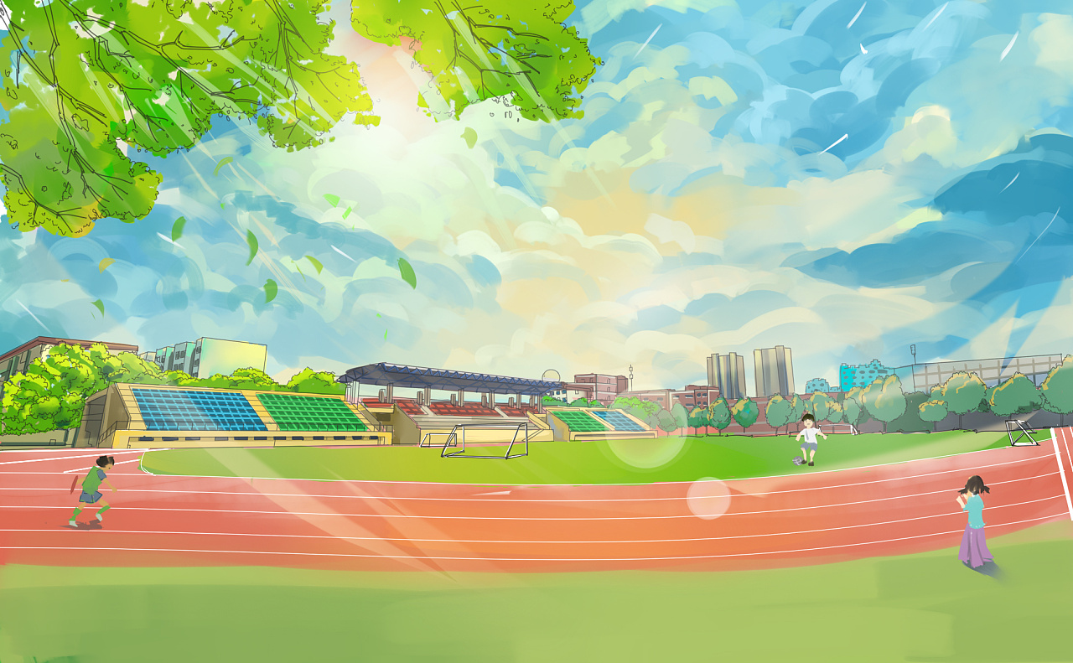
2023年4月广州二模英语应用文

Slide 2
Learning Aims
After learning this lesson, you will
1. understand the structure of news report clearly
2. organize your writing logically
3. use the words and phrases correctly
4.write a news report correctly.

Slide 3
Practice
为庆祝四月二十日中国语言日，你校举办了主题活动。请你为校英文报写一篇报道，内容包括:
1.活动内容:
2.活动反响。
注意:
1.写作词数应为 80 左右:
2.请按如下格式在答题卡的相应位置作答。
Chinese Language Day Celebrations on Campus

Slide 4
第一步审题：5W1H
为庆祝四月二十日中国语言日，你校举办了主题活动。请你为校英文报写一篇报道，内容包括:
1.活动内容:
2.活动反响。
注意:
1.写作词数应为 80 左右:
2.请按如下格式在答题卡的相应位置作答。
5W+1H
What:
When:
Where:
Who：
Why：
How：
校园主题活动
四月二十日
校园
校报记者
为庆祝四月二十日中国语言日
？？？

Slide 5
第二步：搭建结构——三段式
Short&brief eye-catching main idea（通常已给出）
The headline, photo and/or caption
Description of what happened, when, where, and who was involved
Key information(include 5w)
More facts and details and the reactions of those involved
How:
details
Background or supporting information
Influence or assessment

Slide 6
第三步：逐个击破
Chinese Language Day Celebrations on Campus
Para. 1导语:
目的
+ 事件
为了....
with the purpose of
/ aimed at doing sth.
/ aiming to do sth.
who
when
where
what
why
how | /
reporter
on April 20
around the campus
事件
Chinese Language Day Celebrations
To understand and appreciate the beauty of

Slide 7
多样化表达
为了让学生更好地理解和欣赏汉语的美，我校在4月20日“汉语日”举办了一系列庆祝活动。参与者包括语言专家和学校全体师生。
1. On April 20th, our school organized a series of events to celebrate Chinese Language Day, with the participation of language experts, teachers, and students.
2. To celebrate Chinese Language Day,a variety of events was launched with the involvement of language experts, as well as teachers and studentsOn April 20th in our school.
3. April 20, the birthday of Chinese characters’ creator Cang Jie, witnessed the great success ofour school's first ever Chinese Language Day Celebrations.
被动表达
拟人表达

Slide 8
第三步：逐个击破
Para. 2 正文
活动内容&学生们的反应:
the paper-cutting contest
live Chinese Calligraphy show
活动内容
poetry recitation competition
tongue twisters
Chinese debate competition

Slide 9

写作
Para 2: The body (activities and reactions)
useful expressions
There were...
Among those most popular events were
The most impressive part was
What won the most applause was

Slide 10
多样化表达
最受欢迎的是绕口令比赛，吸引了前来参观的留学生们展示他们精彩的汉语口语。
1. It was the tongue twister contest that proved to be the crowd favorite, drawing in international students to exhibit their impressive Mandarin speaking abilities.
2. What was most well-received was the tongue twister challenge, which enticed foreign students to display their remarkable Chinese speaking proficiency.
3. Attracting international students to demonstrate their exceptional Mandarin speaking talents, the tongue twister competition was a hit.
强调句
主语从句
非谓语

Slide 11
第三步：逐个击破
Para. 2 结尾
总结+评论：活动意义
thrive all the way
win the most applause
活动意义
think highly of
have a better understanding of
arouse passion for

Slide 12
写作
Para 3: The end (harvest and feelings)
useful expressions
an opportunity for us to...
a platform for us to...
offer us...
promote...
not only ... but also...
The activity benefited us a lot.
The activity was of great benefit to us.
All of us thought highly of the activity.
The activity was highly spoken of.

Slide 13
第四步：检查润色
1. 词数适当（80词左右）
2. 内容完整，要点全面，语言规范，语篇连贯,符合逻辑关系
3. 使用一些高级词汇或句型（适当运用非谓语动词、从句和一些特殊句型等）

Slide 14
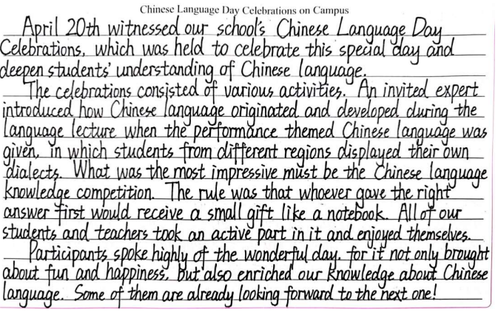
第四档：13分
学生习作
Chinese Language Day Celebrations on Campus
段内逻辑清晰
信息层次分明
书面整洁美观
Notes:
课件来源：脑洞英语课堂
对本课件使用有任何疑问， 请联系小助手：naodong12
更多优质内容，欢迎访问【脑洞备课网】：www.naodongenglish.com

Slide 15
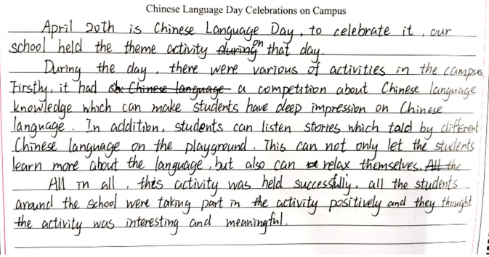
学生习作
Chinese Language Day Celebrations on Campus
第三档：9分
基本符合报道的语篇特征，覆盖了大部分内容要点，
使用了较有效的衔接手段
语言较为简单且错误较多
Notes:
课件来源：脑洞英语课堂
对本课件使用有任何疑问， 请联系小助手：naodong12
更多优质内容，欢迎访问【脑洞备课网】：www.naodongenglish.com

Slide 16
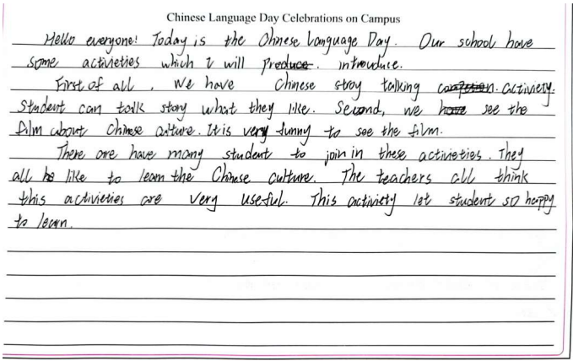
第二档：5分
学生习作
Chinese Language Day Celebrations on Campus
不符合报道的语篇特征
语意表达不清
Notes:
课件来源：脑洞英语课堂
对本课件使用有任何疑问， 请联系小助手：naodong12
更多优质内容，欢迎访问【脑洞备课网】：www.naodongenglish.com

Slide 17
possible version 1
Chinese Language Day Celebrations on Campus
April 20, the birthday of Chinese characters’ creator Cang Jie, witnessed the great success ofour school's first ever Chinese Language Day Celebrations.
On that day, more than 20 events were organized around the campus, offering the fullest experience of the beauty of our mother tongue. Among those most popular events were live Chinese Calligraphy show from our teachers, and the paper-cutting contest, with participants demonstrating delicately designed patterns of Chinese idioms. What won the most applause was the contest of tongue twisters, attracting visiting foreign students to showcase their wonderful oral Chinese.
The celebrations have had a positive effect on every participant. “Chinese language is sobeautiful and interesting, Ill definitely carry on my study into it one visiting student from France” told the reporter.
Notes:
课件来源：脑洞英语课堂
对本课件使用有任何疑问， 请联系小助手：naodong12
更多优质内容，欢迎访问【脑洞备课网】：www.naodongenglish.com

Slide 18
possible version 2
Chinese Language Day Celebrations on Campus
To help students fully understand and appreciate the beauty of our mother tongue, our school held series of celebrations on April 20th, the Chinese Language Day. Participants include language experts and all the school teachers and students.
The celebrations include various wonderful activities. Language experts were invited to write Chinese calligraphy on the scene, winning whole-hearted praises from the audience. There were also speeches given by our teachers on how the Chinese language had thrived all the way through into modern times. The most impressive part was the students’ poetry recitation competition, fully displaying the rhythm and image of Chinese literary works.
Our Chinese Language Day Celebrations proved to be a huge success. Participants thought highly of it, saying that the celebrations have helped them see into our language in a more comprehensive and deeper angle.
Notes:
课件来源：脑洞英语课堂
对本课件使用有任何疑问， 请联系小助手：naodong12
更多优质内容，欢迎访问【脑洞备课网】：www.naodongenglish.com

Slide 19
链接高考
（2020新高考卷I）
假定你是李华，上周日你校举办了5公里越野赛跑活动。请你为校英文报写一篇报道，内容包括：
1. 参加人员：
2. 跑步路线：从校门口到南山脚下：
3. 活动反响。
注意：
1. 写作词数应为80左右；
2. 请按如下格式在写在答题卡的相应位置。
Notes:
课件来源：脑洞英语课堂
对本课件使用有任何疑问， 请联系小助手：naodong12
更多优质内容，欢迎访问【脑洞备课网】：www.naodongenglish.com

Slide 20
possible version
Last weekend, some students took part in an activity organized by the Student Union to do some voluntary work in a nearby neighborhood. Once they got there, they divided themselves into small groups to do different jobs. Some cleaned the street corners; some watered the flowers and plants; others helped the elderly with their housework.
The activity was much praised by the neighborhood and the students also enjoyed it. They got to know the society better and learned how to help people around.
Notes:
课件来源：脑洞英语课堂
对本课件使用有任何疑问， 请联系小助手：naodong12
更多优质内容，欢迎访问【脑洞备课网】：www.naodongenglish.com

Slide 21
Thanks for your Attention ！

